Slide 1

UNIT 4 XML (eXtensible Markup Language)
Information and Communication Technology Department
Markup Languages and Information Management Systems

Slide 2
Origin of XML
Information and Communication Technology Department
It was created to enable generic SGML to be served, received, and processed on the Web in the way that is possible with HTML.
But SGML was a very complex language…
Markup Languages and Information Management Systems

Slide 3
Origin of XML
Information and Communication Technology Department
XML is a subset of SGML that makes it easier to share documents through the Internet or different applications.
Markup Languages and Information Management Systems

Slide 4
Goals of XML
Information and Communication Technology Department
XML shall be straightforwardly usable over the Internet.
XML shall support a wide variety of applications.
XML shall be compatible with SGML.
Markup Languages and Information Management Systems

Slide 5
Goals of XML
Information and Communication Technology Department
It shall be easy to write programs which process XML documents.
The number of optional features in XML is to be kept to the absolute minimum, ideally zero.
XML documents should be human-legible and reasonably clear.
Markup Languages and Information Management Systems

Slide 6
Goals of XML
Information and Communication Technology Department
The XML design should be prepared quickly.
The design of XML shall be formal and concise.
XML documents shall be easy to create.
Terseness in XML markup is of minimal importance.
Markup Languages and Information Management Systems

Slide 7
What is XML?
Information and Communication Technology Department
It is considered a metalanguage, as it is used to define a set of rules for creating new markup languages.
Markup Languages and Information Management Systems

Slide 8
What is XML?
Information and Communication Technology Department
Its first W3C Recommendation is written in this page: http://www.w3.org/TR/REC-xml/
Markup Languages and Information Management Systems

Slide 9
Parsers
Information and Communication Technology Department
A parser is an XML processor used to read XML documents and provide access to their content and structure.
Markup Languages and Information Management Systems

Slide 10
Example of XML document
Information and Communication Technology Department
<?xml version="1.0" encoding="UTF-8"?>
<film>
Moonlight
<director>Barry Jenkins</director>
<actors>
<actor>Mahershala Ali</actor>
<actor>Shariff Earp</actor>
</actors>
</film>
Markup Languages and Information Management Systems

Slide 11
Example of XML document
Information and Communication Technology Department
Can you explain the meaning of this document?
Can you identify its different parts?
Markup Languages and Information Management Systems

Slide 12
Example of XML document
Information and Communication Technology Department
Install XML Copy Editor on your computer.
Write the previous text and save it as moonlight.xml.
Open the file using your Internet browser.
Markup Languages and Information Management Systems

Slide 13
Example of XML document
Information and Communication Technology Department
What can you see?
Write a mistake in the document, save and open it with your browser again. What happens?
Markup Languages and Information Management Systems

Slide 14
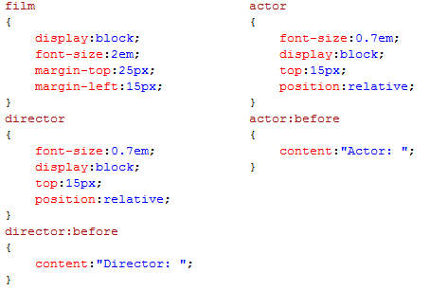
Applying style
Information and Communication Technology Department
Markup Languages and Information Management Systems

Slide 15
Applying style
Information and Communication Technology Department
Write this CSS document and save it as mystyle.css.
Add, as the second line of your XML document, <?xml-stylesheet type=“text/css" href=“mystyle.css"?>.
Open the file using your Internet browser. What can you see?
Markup Languages and Information Management Systems

Slide 16
Well-formed XML Documents
Information and Communication Technology Department
The prolog which provides information about the document.
The document body contains the contents in a hierarchical structure.
The epilog (optional) contains final comments and processing instructions.
Markup Languages and Information Management Systems

Slide 17
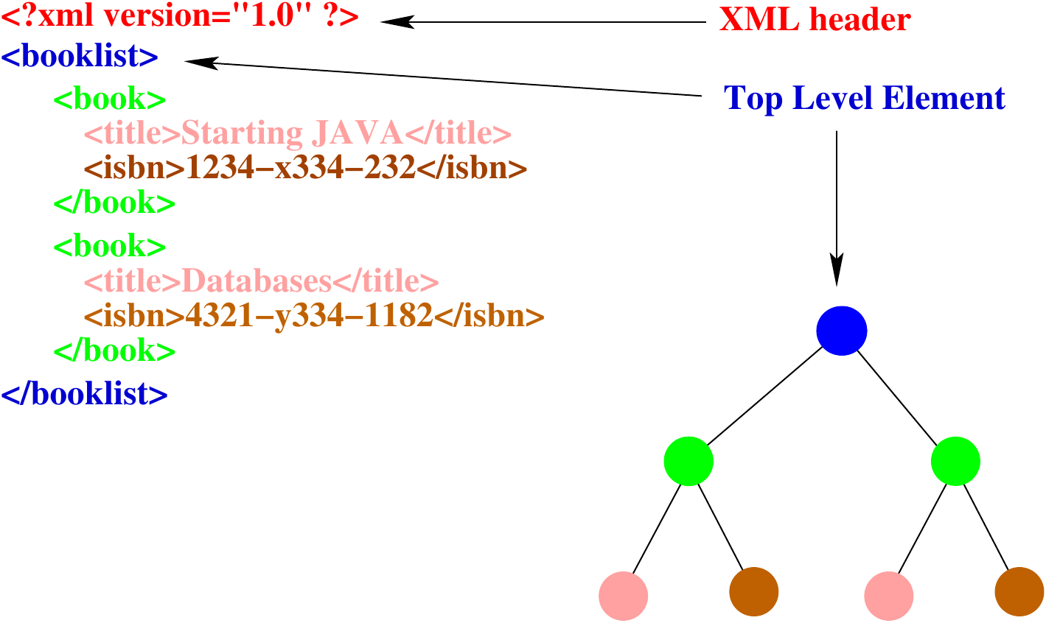
Well-formed XML Documents
Information and Communication Technology Department
Markup Languages and Information Management Systems

Slide 18
Prolog
Information and Communication Technology Department
<?xml version="1.0" encoding="UTF-8“ standalone=“yes”?>
<?xml-stylesheet type=“text/css" href=“mystyle.css"?>
Markup Languages and Information Management Systems

Slide 19
Body
Information and Communication Technology Department
Rules for elements
XML documents can have only one root element.
Every start-tag must have a matching end-tag.
Tags can't overlap.
Element names must obey XML naming conventions.
XML is case-sensitive.
XML will keep white space in your text.
Markup Languages and Information Management Systems

Slide 20
Body
Information and Communication Technology Department
Rules for element names
Names can start with letters or the "_" character, but not numbers or other punctuation characters.
After the first character, numbers are allowed, as are the characters "-" and ".".
Names can't contain spaces.
Markup Languages and Information Management Systems

Slide 21
Body
Information and Communication Technology Department
Rules for element names
Names can't contain the ":" character. Strictly speaking, this character is allowed, but the XML specification says that it's “reserved“ for namespaces.
Names can't start with the letters "xml", in uppercase, lowercase, or mixed.
Markup Languages and Information Management Systems

Slide 22
Create the XML document with three paragraphs.
Information and Communication Technology Department
message
from
to
subject
content
name
email
name
email
paragraph
Markup Languages and Information Management Systems

Slide 23
Body
Information and Communication Technology Department
Attributes are simple name/value pairs associated with an element.
They are attached to the start-tag but not to the end-tag.
Markup Languages and Information Management Systems

Slide 24
Create an XML document for this information tree.
Information and Communication Technology Department
song
length= “4:47”
date-released=”2008”
title
composers
producers
artist
Give it 2 me
composer
producer
Madonna
name
surname
name
surname
Pharrell
Williams
Pharrell
Williams
Markup Languages and Information Management Systems

Slide 25
Expand the previous document in this way:
Information and Communication Technology Department
Use a “disc” element with:
“serial” and “disc-length” attributes.
“title”, “date-released” and three “song” elements.
Markup Languages and Information Management Systems

Slide 26
Write this simple XML document:
Information and Communication Technology Department
<?xml version="1.0" encoding="UTF-8"?>
<comparison>6<7</comparison>
Is it a well-formed document? Why?
Markup Languages and Information Management Systems

Slide 27
Entity References
Information and Communication Technology Department
Character | Name | Entity Reference
< | less than | &lt;
> | greater than | &gt;
& | ampersand | &amp;
‘ | apostrophe | &apos;
“ | quotation mark | &quot;
Modify the previous document in order to be well-formed.
Markup Languages and Information Management Systems

Slide 28
CDATA Sections
Information and Communication Technology Department
They are not parsed by the XML processor so they are very usefull in texts with many “illegal” characters.
CDATA sections begin with <![CDATA[ and end with ]]>.
Markup Languages and Information Management Systems

Slide 29
CDATA Sections
Information and Communication Technology Department
<script>
<![CDATA[ function match(a,b) {
if (a < b && a < 0)
{ return 1; }
else { return 0; } }
]]>
</script>
Markup Languages and Information Management Systems

Slide 30
Comments
Information and Communication Technology Department
They start with the string <!-- and end with the string -->
<name nickname='Shiny John'>
<first>John</first>
<!--John lost his middle name in a fire-->
<middle></middle>
<last>Doe</last>
</name>
Markup Languages and Information Management Systems

Slide 31
Namespaces
Information and Communication Technology Department
There are frequent conflicts when trying to mix XML documents from different XML applications.
<?xml version="1.0" encoding="utf-8"?>
<collection>
<item>
<title>Hidden figures</title>
<author>M.L. Shetterly</author>
<price>19.99</price>
</item>
<item>
<title>A man called Ove</title>
<author>Fredrik Backman</author>
<price>19.59</price>
</item>
</collection >
<?xml version="1.0" encoding="utf-8"?>
<collection>
<item>
<title>A head full of dreams</title>
<singer>Coldplay</singer>
<price>7.99</price>
</item>
<item>
<title>Ghost stories</title>
<singer>Coldplay</singer>
<price>7.99</price>
</item>
</collection>
Markup Languages and Information Management Systems

Slide 32
Namespaces
Information and Communication Technology Department
We can define different namespaces for book and disc elements.
<?xml version="1.0" encoding="utf-8"?>
<collection xmlns:book=“Mybooks”>
<book:item>
<book:title>Hidden figures</book:title>
<book:author>M.L. Shetterly</book:author>
<book:price>19.99</book:price>
</book:item>
<book:item>
<book:title>A man called Ove</book:title>
<book:author>F. Backman</book:author>
<book:price>19.59</book:price>
</book:item>
</collection >
<?xml version="1.0" encoding="utf-8"?>
<collection xmlns:disc=“Mydiscs”>
<disc:item>
<disc:title>A head full of dreams</disc:title>
<disc:singer>Coldplay</disc:singer>
<disc:price>7.99</disc:price>
</disc:item>
<disc:item>
<disc:title>Ghost stories</disc:title>
<disc:singer>Coldplay</disc:singer>
<disc:price>7.99</disc:price>
</disc:item>
</collection>
Markup Languages and Information Management Systems

Slide 33
Namespaces
Information and Communication Technology Department
Now we can mix the data from both documents safely.
<?xml version="1.0" encoding="utf-8"?>
<collection xmlns:book=“Mybooks” xmlns:disc=“Mydiscs”>
<book:item>
<book:title>Hidden figures</book:title>
<book:author>M.L. Shetterly</book:author>
<book:price>19.99</book:price>
</book:item>
<book:item>
<book:title>A man called Ove</book:title>
<book:author>F. Backman</book:author>
<book:price>19.59</book:price>
</book:item>
<disc:item>
<disc:title>A head full of dreams</disc:title>
<disc:singer>Coldplay</disc:singer>
<disc:price>7.99</disc:price>
</disc:item>
….
</collection>
Markup Languages and Information Management Systems

Slide 34
Namespaces
Information and Communication Technology Department
We can choose the name of namespace, even we can use a URI.
Uniform Resource Locator (URL)
<collection xmlns:book=“http://www.example.com/bookinfo/ ”>
Uniform Resource Name (URN)
<collection xmlns:book=“urn:mybookstuff.org:bookinfo”>
Markup Languages and Information Management Systems

Slide 35
Default namespaces
Information and Communication Technology Department
They save us from using prefixes in all the child elements.
<?xml version="1.0" encoding="utf-8"?>
<collection xmlns=“Mybooks” >
<item>
<title>Hidden figures</title>
<author>M.L. Shetterly</author>
<price>19.99</price>
</item>
<item>
<title>A man called Ove</title>
<author>Fredrik Backman</author>
<price>19.59</price>
</item>
</collection >
All the elements inside <collection> belong to “Mybooks” namespace.
Markup Languages and Information Management Systems

Slide 36
Namespaces
Information and Communication Technology Department
Can you guess the namespace for each element?
<?xml version="1.0" encoding="utf-8"?>
<collection xmlns=“Mybooks” xmlns:disc=“Mydiscs”>
<item>
<title>Hidden figures</title>
<author>M.L. Shetterly</author>
<price>19.99</price>
</item>
<item>
<title>A man called Ove</title>
<author>F. Backman</author>
<price>19.59</price>
</item>
<disc:item>
<disc:title>A head full of dreams</disc:title>
<disc:singer>Coldplay</disc:singer>
<disc:price>7.99</disc:price>
</disc:item>
….
</collection>
Markup Languages and Information Management Systems

Slide 37
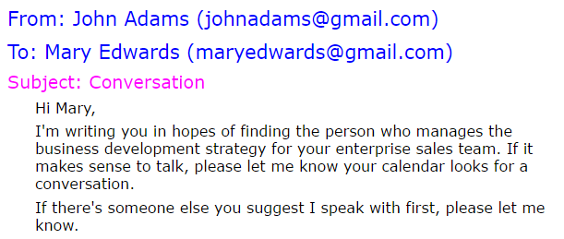
Activities
Information and Communication Technology Department
Rewrite the e-mail document using a namespace called “Mymailing”.
Modify the previous document in order to turn “Mymailing” into a default namespace.
Apply a stylesheet to the document to be shown this way by the browser:
Markup Languages and Information Management Systems

Slide 38
Tools
Information and Communication Technology Department
There several types of tools to determine if a XML document is well-formed:
Web clients or Internet browsers.
Online check (http://validator.w3.org).
Applications (XML Copy Editor, etc.).
Libraries.
Markup Languages and Information Management Systems

